Slide 1
IRON MAN SUIT
A project with EPITECH

Slide 2
GANTT
Voir PDF

Slide 3
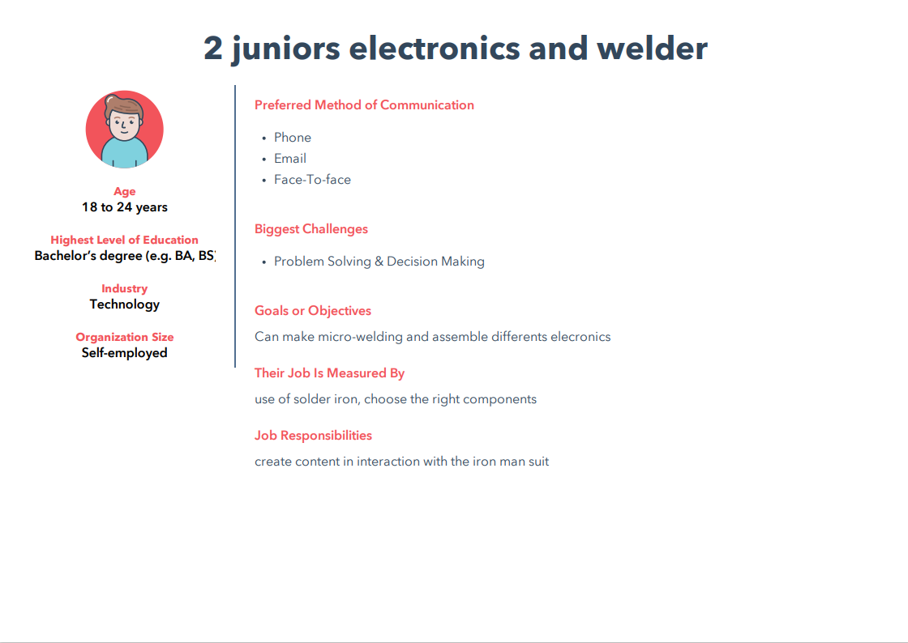
PERSONA

Slide 4
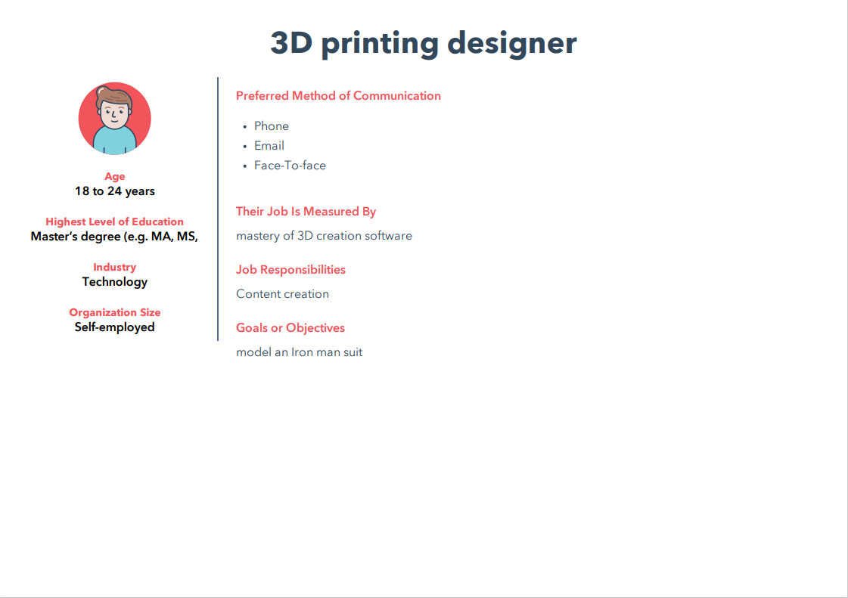

Slide 5
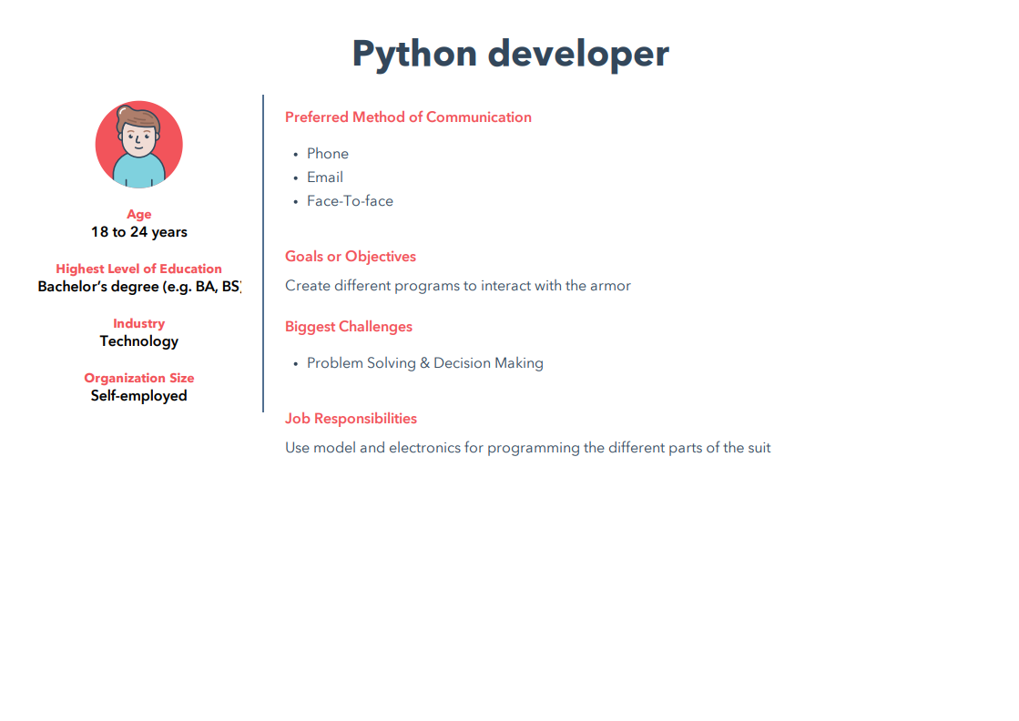

Slide 6
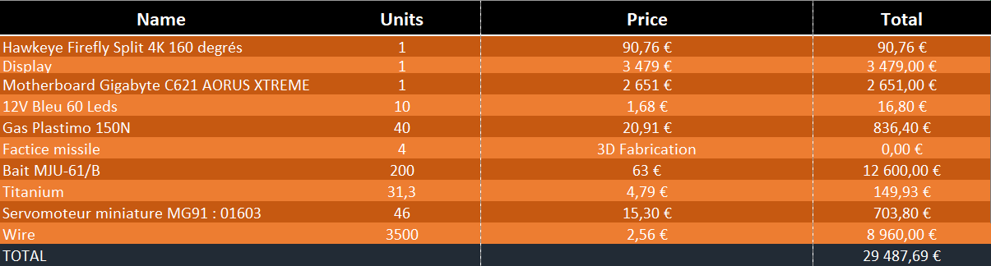
BUDGET

Slide 7
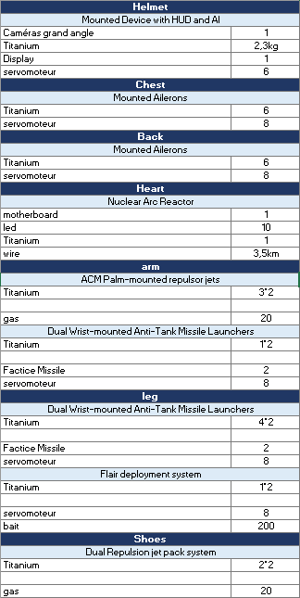
RESSOURCES

Slide 8
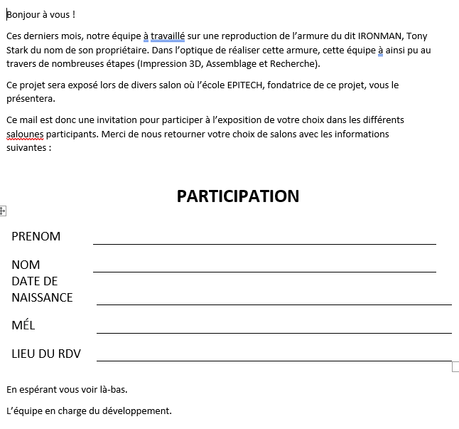
MAIL

Slide 9
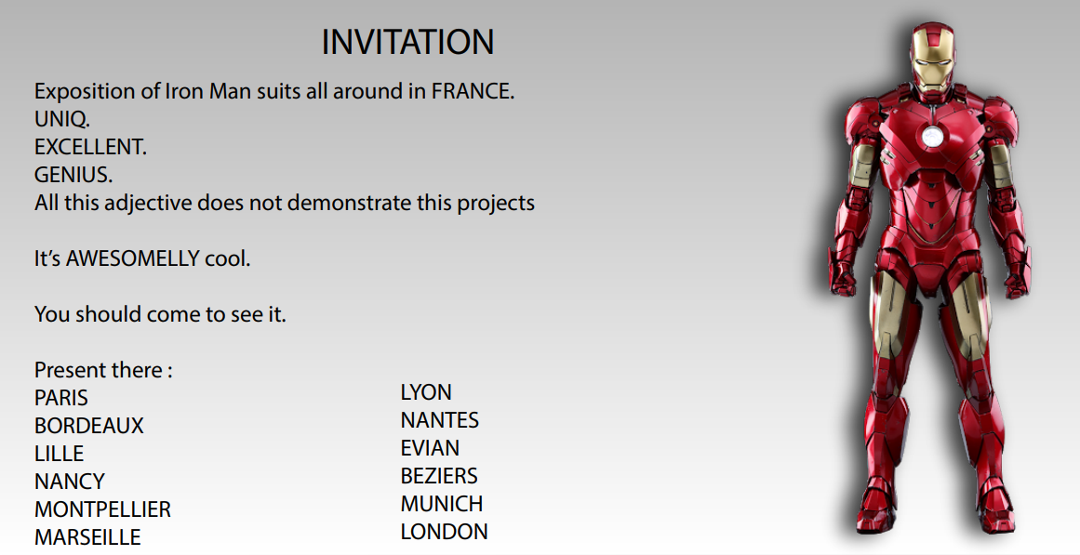
INVITATION

